Slide 1

Big Mountain Resort
Pricing Model

Slide 2
Problem Identification
GOAL - Increase revenue by $1,540,000 within the season to pay for new chairlift that was installed
Current strategy - Charge higher prices than competitors
How do you justify the new prices?
Potential for missed opportunity
New Strategy – Build predictive model for ticket price based on resort facilities
Use data on US resorts to identify features that would support higher ticket prices
Predict prices based on free market valuation of those facilities

Slide 3
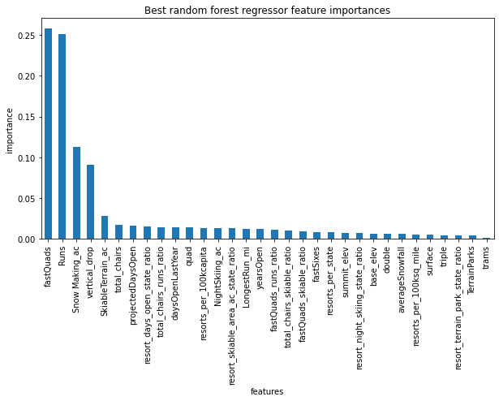
Recommendations and Key Findings
Recommendation: Increase vertical drop, add a run and a chairlift:
Increase per ticket - $1.99
Revenue increases (one season) - $3,474,638
Big Mountain ranks high among many features high in importance in our model:
Snow making area (3rd in our model)
Fast quads (1)
Runs (2)
Longest run
Skiable terrain area (5)
Vertical Drop (4th in our model) is relatively high for Big Mountain resort but not among the highest

Slide 4
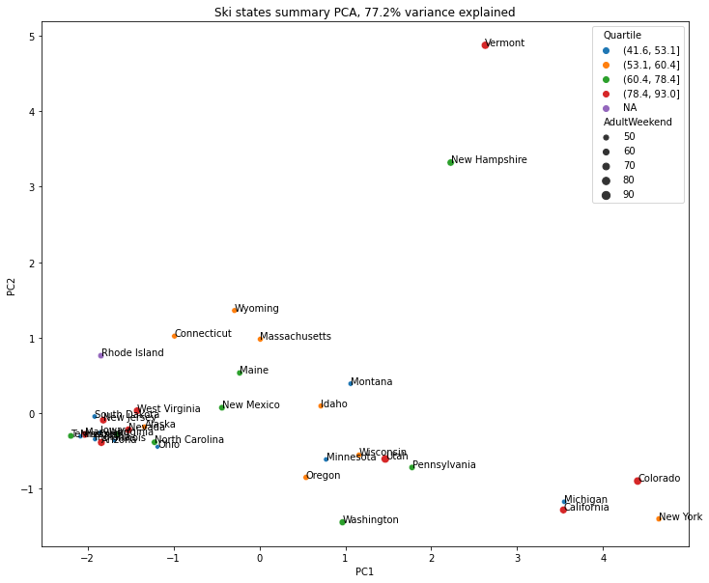
Target Value and State Labels
Target value: Adult weekend price
Treat states equally:
Big spread of states across 1st component
Vermont/New Hampshire are outlines of 2nd components: high resort density
Big spread of average price and quartiles

Slide 5
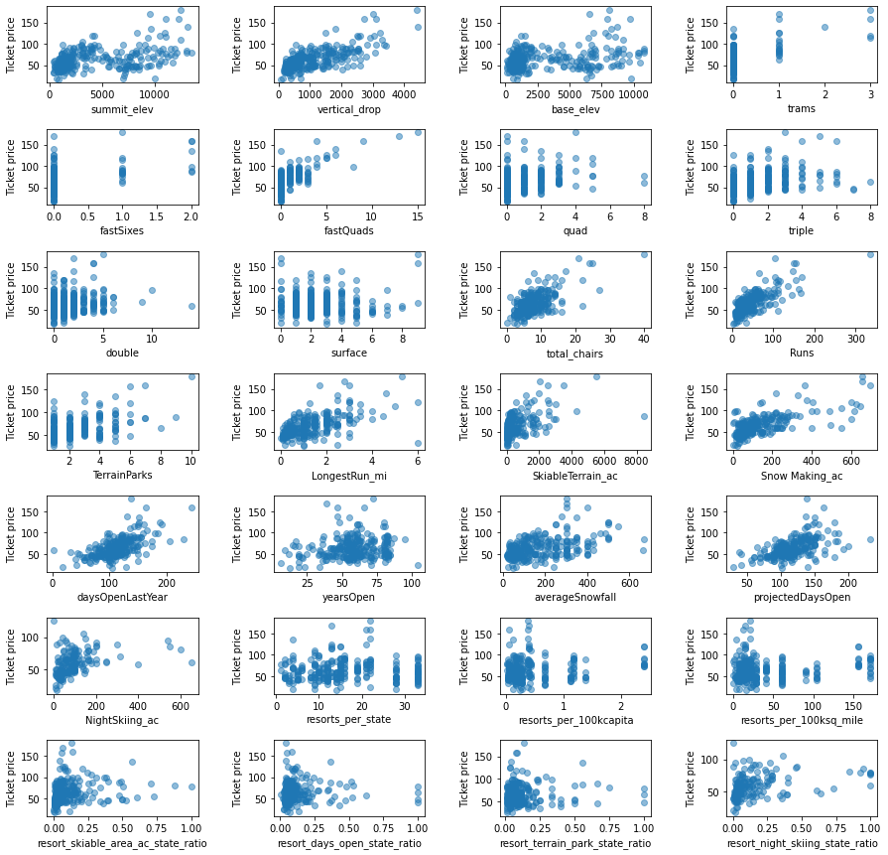
EDA - Feature Correlation
Features highly correlated with ticket price:
Vertical drop
Fast quads
Number of runs
Snow making acers

Slide 6
Building Model
Baseline Model
Use mean to predict the value
Error - $19
Linear regression model:
Impute missing features with the median
Explains 80% of train set's variance and 70% on the test set – Overfitting?
Estimates the price to within $9
Random forest model (chosen model):
Lower cross-validation mean absolute error by almost $1 with less variability

Slide 7
Modeling Scenarios
Scenario 1 - Close up to 10 of the least used runs: This model results in a price drop or no change in price at all
Scenario 2 and 3 - Add a run, increase the vertical drop by 150 feet, and install an additional chair lift (with or without adding 2 acres of snow making): Supports an increase in ticket price by $1.99 and a revenue increase of $3,474,638
Scenario 4 - Increase the longest run by 0.2 miles and add 4 acres of snow making capability: No difference in ticket price

Slide 8
Conclusion and Summary
Modelled price (using all features) - $95.87 (MAE of $10.39) vs. current price - $81
Big Mountain is doing well for vertical drop (4th important in model), but there are still quite a few resorts with a greater drop
Big mountain resort already ranks very high for the top 3 features of importance, fast quads, runs and snow making area
The scenario with a 150 feet vertical drop increase (and adding a run and a chairlift) resulted in an extra revenue of $3,474,638 while only increasing ticket price by $1.99

